Slide 1

Student details
Name:Mallipudi Divya Tridhara
Skillsbuild email id: divyatridhara@gmail.com
College name:Kakinada Institute of Engineering and Technology
College state:Andhra Pradesh
Internship domain START AND END DATE:AI,9/6/2023(STARTED) AND 7/6/2023(ENDED)

Slide 2
PROJECT OVERVIEW
The Student Portfolio Development project aims to empower students to take ownership of their learning journey and showcase their academic progress, skills, and achievements through the creation of personalized portfolios. The portfolio will serve as a comprehensive representation of each student's abilities, growth, and potential, providing a deeper insight into their educational experience beyond traditional assessments.

Slide 3
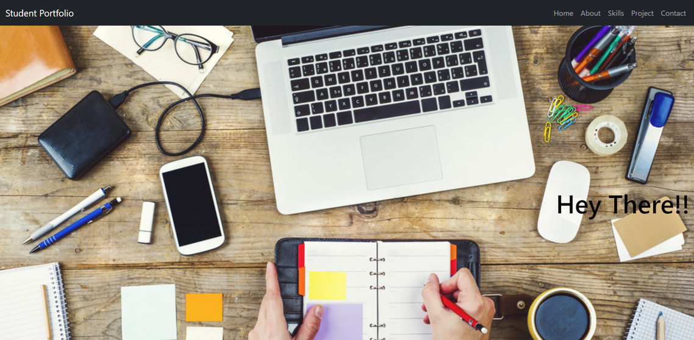
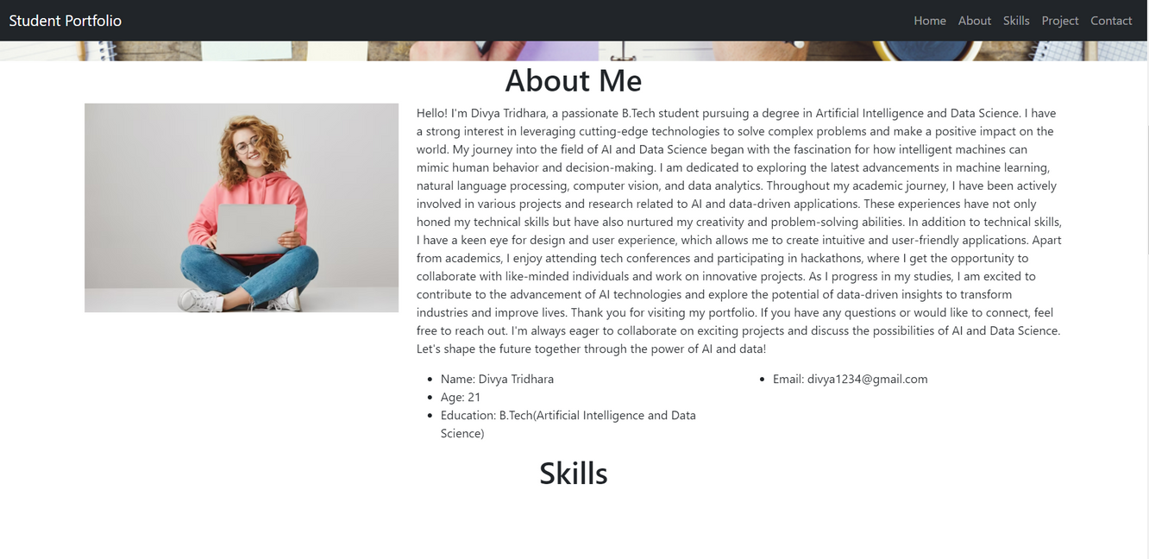
STUDENT PORTFOLIO

Slide 4
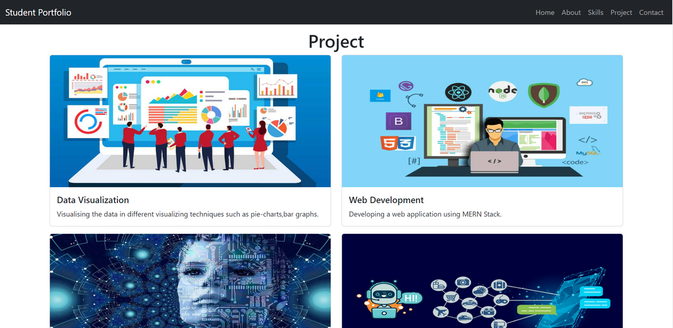
WHAT IS STUDENT PORTFOLIO?
A student portfolio is a collection of work and accomplishments that showcase a student's academic progress, skills, talents, and achievements. It serves as a comprehensive representation of a student's abilities, growth, and potential. Portfolios are widely used in education and can be beneficial for students at various academic levels, from elementary school to college and beyond.

Slide 5
END USERS OF THE PROJECT
Students: Students themselves are significant end users of their portfolios. Portfolios empower students to take ownership of their learning journey by actively selecting and curating their best work. Reflective elements in the portfolio allow students to evaluate their progress, identify areas of growth, and set goals for personal development.
Colleges and Universities: For students applying to colleges and universities, the portfolio can be an essential component of the application process. College admission officers review portfolios to gain insights into applicants' academic abilities, achievements, and personal growth.
Employers: In some cases, student portfolios may also serve as a tool for job applications and interviews. Recent graduates or individuals seeking employment can use their portfolios to showcase their skills, academic achievements, and relevant experiences. Employers may find portfolios valuable for assessing a candidate's potential and suitability for a specific role.

Slide 6
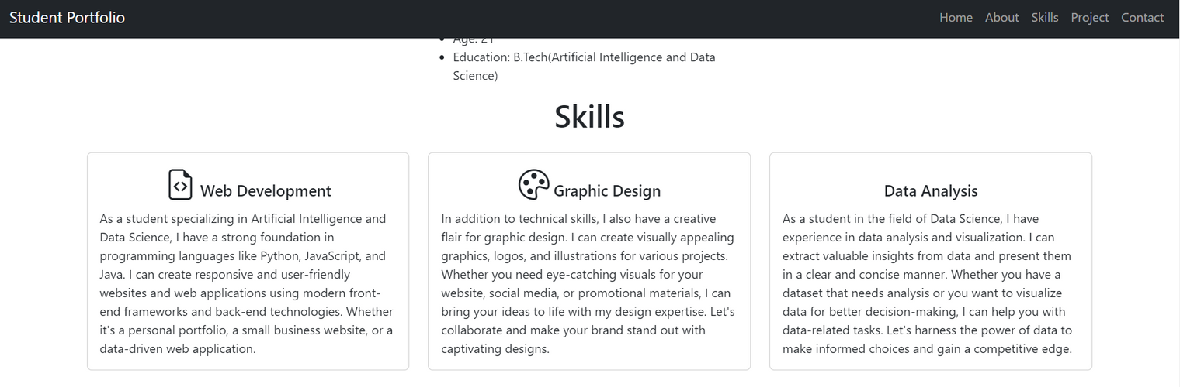
CONCLUSION
The Student Portfolio Development project aims to foster a culture of self-directed learning and reflection, empowering students to become active participants in their educational journey. By showcasing their growth and achievements through portfolios, students will have valuable tools for college applications, job interviews, and beyond, setting them up for success in their future endeavors.

Slide 7
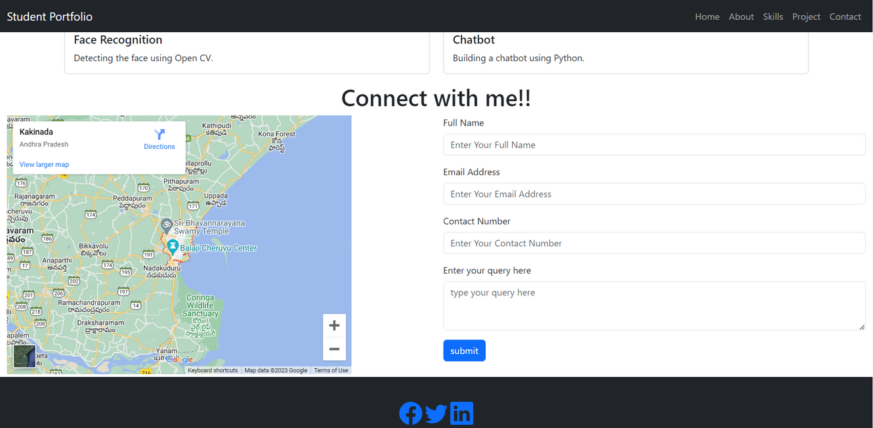
LINKS
GITHUB: https://github.com/divyatridhara
Project Repository: https://github.com/divyatridhara/edunet_project

Slide 8
THANK YOU

